Slide 1
Art and AI:
Outbreaks from the Grid
Student: Ethan Davis, University of Vermont
ethan.davis@uvm.edu
Mentor: Adrian Del Maestro, University of Vermont
Adrian.DelMaestro@utk.edu
Researcher: Jenn Karson, University of Vermont, Jennifer.Karson@uvm.edu
June 15, 2020

Slide 2
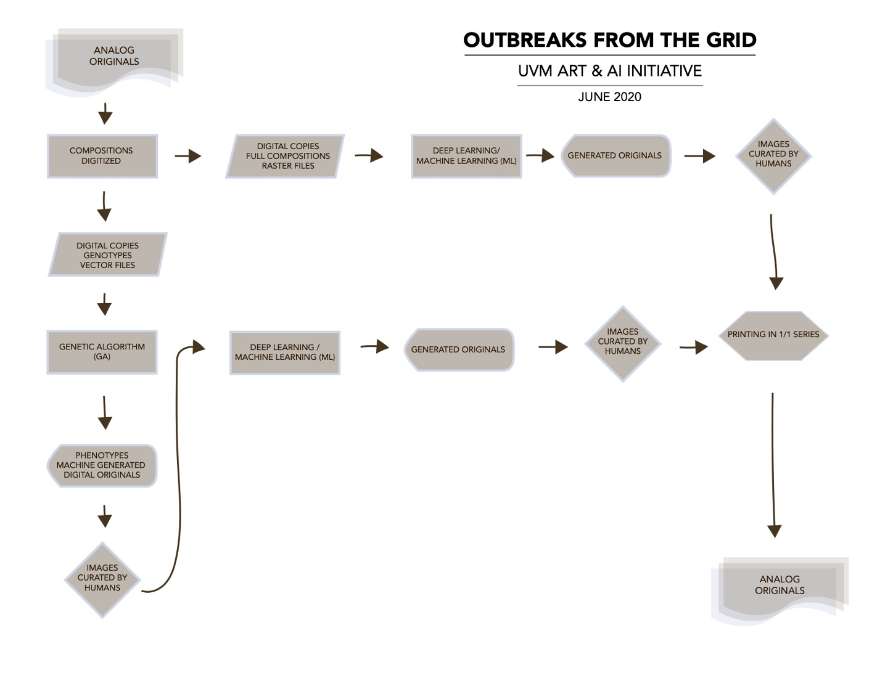
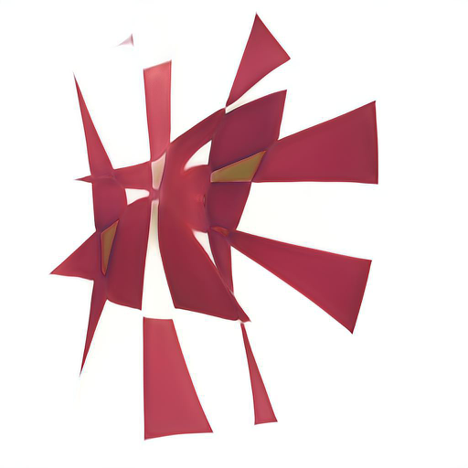
Art and AI:
Outbreaks from the Grid
Utilizing machine learning and artificial life to create novel compositions

Slide 3
Art and AI:
Outbreaks from the Grid
Goals
  Digitize shapes from existing artworks
  create new compositions using genetic algorithm
  Use new compositions to train a GAN to create novel images

Slide 4
Art and AI:
Outbreaks from the Grid
Timeframe
  June 2020
  August 2020

Slide 5
Art and AI:
Outbreaks from the Grid
What I hope to learn
  Programming in Processing
  creating software for art-making
  learn about neural networks and genetic algorithms

Slide 6
Art and AI:
Outbreaks from the Grid
Goals for Next Month
  Create large dataset using a genetic algorithm
  Train a GAN using the new dataset

Slide 7
Art and AI:
Outbreaks from the Grid
Help needed (if any)
  Advice on creating custom GANs using keras
  Advice on utilizing HPC for neural network training

